Slide 1


Objectives
In this session, you will learn to:
  Apply transitions, animations, and transformations
  Create tables

Slide 2
Applying Transitions, Animations, and Transformations
CSS:
  Provides an easy way to apply animation effects on HTML elements.
  Has a set of predefined properties and functions for applying animations.

Slide 3
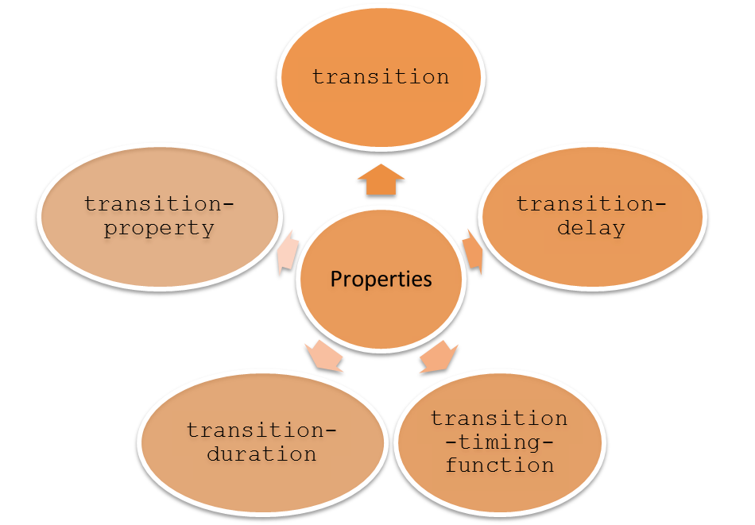
Applying Transitions
The CSS transitions:
  Provide a way to moderately change the HTML element from one position to another.
  Can be applied using the following properties:

Slide 4
Applying Animations
A CSS animation:
  Provides a way to moderately change the HTML elements.
  Can be controlled for iterations, alterations, and states.
  Is defined by specifying the animation styles within an animation rule.

Slide 5
Applying Animations (Contd.)
An animation rule:
  Includes a set of properties and methods used to create an animation.
  Is created by using the following syntax:
    @keyframe keyframename
    {
    from {property: value;}
    to{property: value;}
    }

Slide 6
Applying Animations (Contd.)
An animation is connected with the HTML elements by using the following
properties:
animation-name
animation-delay
animation-play-state
animation-direction
animation-duration
animation
animation-iteration-count
animation-timing-function

Slide 7
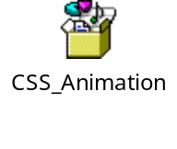
Applying Animations (Contd.)
    The following embedded Notepad file contains the code to create an animation rule and bind it with an HTML element:

Slide 8
Applying Transformations
The CSS transformations:
  Are used to modify the appearance of HTML elements.
  Are used to rotate, scale, and skew HTML elements.
  Can be applied by using the following syntax:
  transform: none| transform-functions;
  Are divided in the following categories:
    2D transforms
    3D transforms

Slide 9
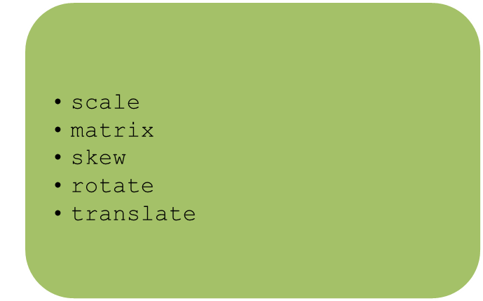
Applying Transformations (Contd.)
2D transforms:
  Are used to apply various transformations, such as rotations or translations on the HTML elements.
  Are applied by using the following methods:

Slide 10
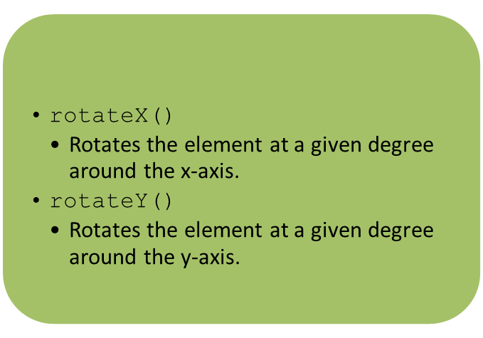
Applying Transformations (Contd.)
3D transforms can also be used to format the HTML elements by using the following methods:

Slide 11
Just a Minute
Which one of the following 2D functions is used to increase or decrease the size
of an HTML element?
  translate()
  rotate()
  skew()
  scale()

Slide 12
Just a Minute (Contd.)
Solution:
  scale()

Slide 13
Demo: Applying Transitions, Animations, and Transformations
Problem Statement:
  Steve has applied the styles to enhance the look and feel of the home page of ShowOnWheels. Now, he wants to apply certain animations on the Web page to make the website appealing. For this, Steve decides to change the color of the following text:
  HURRY UP!
  Help Steve to implement the preceding style.
  Prerequisite: To perform this activity, you need to use the solution file of Activity 2.1. Ask your faculty to provide you the same.

Slide 14
Demo: Applying Transitions, Animations, and Transformations (Contd.)
Solution:
  To implement the animation in the home page, you need to perform the following tasks:
  1. Create the ID selectors for animation in the homestylesheet.css file.
  2. Embed the animation in the home.html file.
    3. View the home.html file.

Slide 15

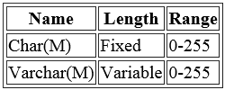
Creating Tables
A Web page of LearnMySQL website displays the content on data types in the following format.
Can be made more understandable if arranged in a table

Slide 16
Identifying the Basic Structure of a Table
Tables in HTML:
  Are used to display information, arranged in the form of rows and columns.
  Are created using the <TABLE> tag.
  Can have a border.
  Are divided into the following logical sections:
    Body
    Header
    Footer

Slide 17

Identifying the Basic Structure of a Table (Contd.)
The table body is created using the <TBODY> tag and contains the data
arranged in rows.
Rows are created using the <TR> and </TR> container tags and comprise
one or more columns.
Columns are created using the <TD> and </TD> container tags.
Multiple rows and columns can be merged into one cell using the rowspan
and colspan attributes, respectively.
  The following embedded Notepad file contains the code to create a table in HTML:

Slide 18

Identifying the Basic Structure of a Table (Contd.)
The table header is a row or collection of rows that contains the headings for the columns of the table.
The row or rows comprising the header content of a table can be grouped using the <THEAD> tag.
The headings for the table columns in the header row are created using the <TH> tag.
A summary for the table rows can be provided in the footer section of a table.
The footer is created using the <TFOOT> tag that is specified after the <THEAD> tag.
The table can be given a title using the <CAPTION> tag.
  The following embedded Notepad file contains the code to create a table with a caption, header, and footer in HTML:
Use the animation, HTML_03_Creating_Enhancing_Tables.swf, to understand the concept of tables.

Slide 19
Just a Minute
Which one of the following tags specifies the content of the columns of a table?
  <TD>
  <CAPTION>
  <TBODY>
  <TH>

Slide 20
Just a Minute (Contd.)
Solution:
  <TD>

Slide 21
Summary
In this session, you learned that:
  The CSS transitions provide a way to moderately change the HTML element from one position to another.
  To specify the animation styles, you need to create certain animation rules known as @keyframe, which is a rule, where the animation is created.
  CSS transformations have the following categories:
    2D Transforms
    3D Transforms
  Tables are used in Web pages to enhance the readability by presenting information in a structured way.
  You can create a table in HTML by using the <TABLE> tag.
  The rows of the body of a table can be grouped by using the <TBODY> tag.
  For adding rows to a table, the <TR> tag is used.
  For adding columns to a row, the <TD> tag is used.
  To extend or merge the cells up to the desired columns, you can use the colspan attribute. Similarly, to merge the rows, you can use the rowspan attribute.
  The table header is a row that contains the headings for the columns of the table.
  To create the headings for the table columns, you can use the <TH> tag.
  For creating a table title, the <CAPTION> tag is used.

